Slide 1
Introduction to Git

Slide 2
What is Git?
Version Control System for tracking changes in computer files.
Distributed version control
Coordinates work between multiple developers
Who made what changes and when
Revert back at any time
Local and remote repos

Slide 3
Basic Commands
git init // initialize local git repository
git add <file> // add file(s) to index
git status //check status of working tree
git commit //commit changes in index
git push // push to remote repository
git pull // pull latest from remote repository
git clone // clone repository to a new directory

Slide 4
Step 1: Install Git
Linux (Debian) – $ sudo apt-get install git
Linux (Fedora) – $ sudo yum install git
Mac – http://git-scm.com/download/mac
Windows – http://git-scm.com/download/win

Slide 5
git --version
git help <command>
After you create a project:
git init
ls or dir to view files
ls -a or dir -a to view all files
git config --global user.name “My Name”
git config --global user.email “me@email.com”
git config --list

Slide 6
git add . // to add all files
or git add <filename>
git rm --cached <filename> // to unstage file
git commit
i // insert mode
type a comment or remove the # sign to uncomment
ESC button to exit insert mode
:wq // execute the commit
or, more simply, type:
commit –m “description of commit”

Slide 7
git diff <filename> // Show differences between index and working tree; that is, changes you haven't staged to commit
git diff --cached // Show differences between current commit and index; that is, what you're about to commit
press ‘q’ to exit
git add –p // to view changes before adding
git restore --stage <filename> // to unstage file
git restore <filename> // to discard changes in working dir

Slide 8
git log // to view history of commits
git log -p // to views history of commits with details of changes made
touch .gitignore from CLI to add a gitignore file
add in the .gitignore file any file or directory you do not wish to commit

Slide 9
git branch <branch name> // create a branch
git branch // see local braches
git branch -r // see remote branches
git branch -a // see all branches
git checkout <branch name> // switch to branch
git merge <branch name> // merge branch with current branch
git revert <value of commit> // adds a new commit that copies the stage you wish to revert to
git reset <value of commit> // rollback to previous commit

Slide 10
Remote Repository
Create an account on github.com
git remote // lists remote repos
git remote add origin <link from github>
example:
git remote add origin https://github.com/oravprojects/myOctApp.git

Slide 11
git push -u origin main
if you have permission error because of multiple accounts, you may have to generate an ssh-key
git push // after the initial push, further pushes to remote repo can be done with the command
git clone <paste repo’s link>

Slide 12
The Owner needs to give the Collaborator access. On GitHub, click the settings button on the right, select Manage access, click Invite a collaborator, and then enter your partner's username. To accept access to the Owner's repo, the Collaborator needs to go to https://github.com/notifications.

Slide 13
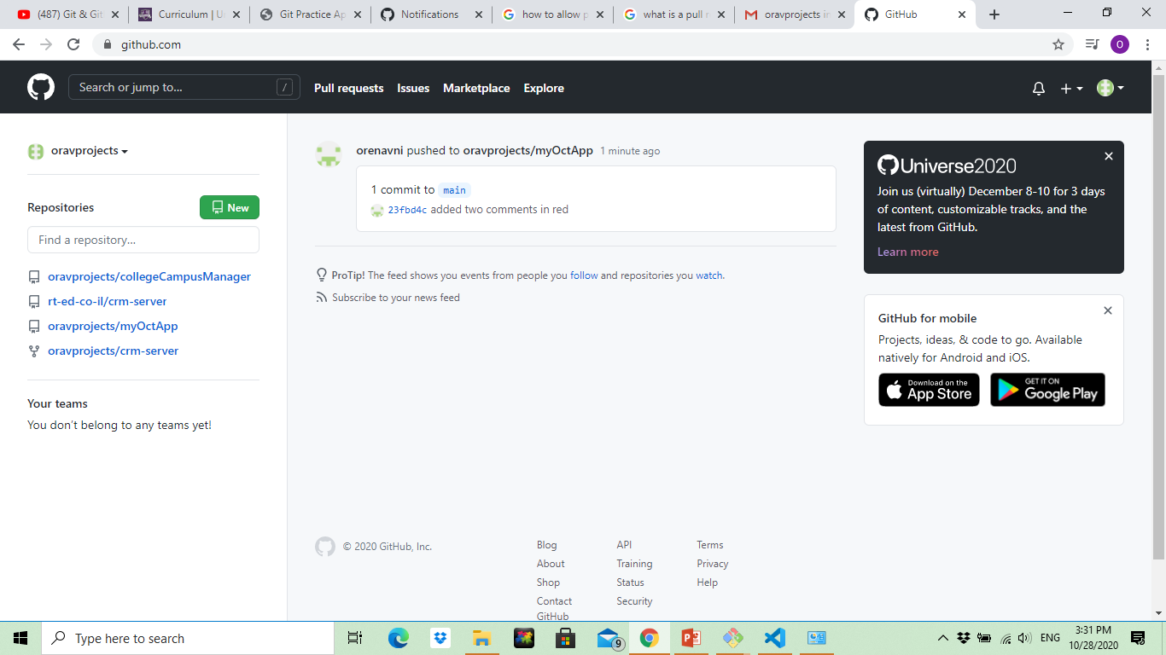

Slide 14
git remote update
git status
git fetch origin // fetch changes from remote
git log main..origin/main // show commit logs of changes
git diff main..origin/main
git merge origin/master

